Slide 1
Wholesale customer segmentation analysis. (clustering)
Group 2
NAMES | REG. NO
TURYA JOHN STEVEN | 2023-B071-21285
WALWASA NATHAN ABEL | 2023-B071-21203
SSEMANDA JONATHAN | 2023-B071-22335
NALULE CATHERINE | 2023-B071-22337
NSUBUGA NICHOLAS PAUL | 2023-B071-22173

Slide 2
OVERVIEW
Objective.
To segment wholesale customers into distinct, meaningful groups based on their annual spending patterns across different product categories.
Business goal.
To move beyond a one-size-fits-all strategy by enabling data-driven decision-making. The key aims are to:
Create targeted and effective marketing campaigns.
Optimize inventory and stock management.
Personalize sales strategies to enhance customer relationships.
Our approach.
We employed unsupervised machine learning to uncover natural groupings in the data. The process involved:
Data preparation: Cleaning the data and applying a log transformation to normalize spending distributions.
Segmentation modeling: Using the K-Means algorithm to cluster customers, validating the optimal number of segments with the Silhouette Score.
Profile analysis: Defining "who" each customer segment is by analyzing their core purchasing habits and validating these profiles against existing business channels.

Slide 3
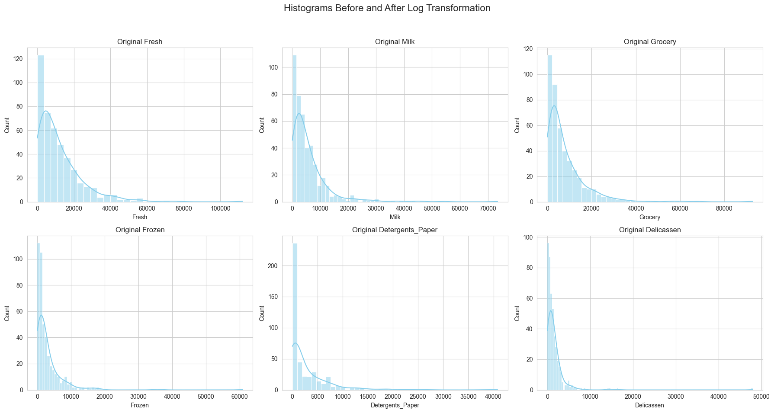
Log transformation before

Slide 4
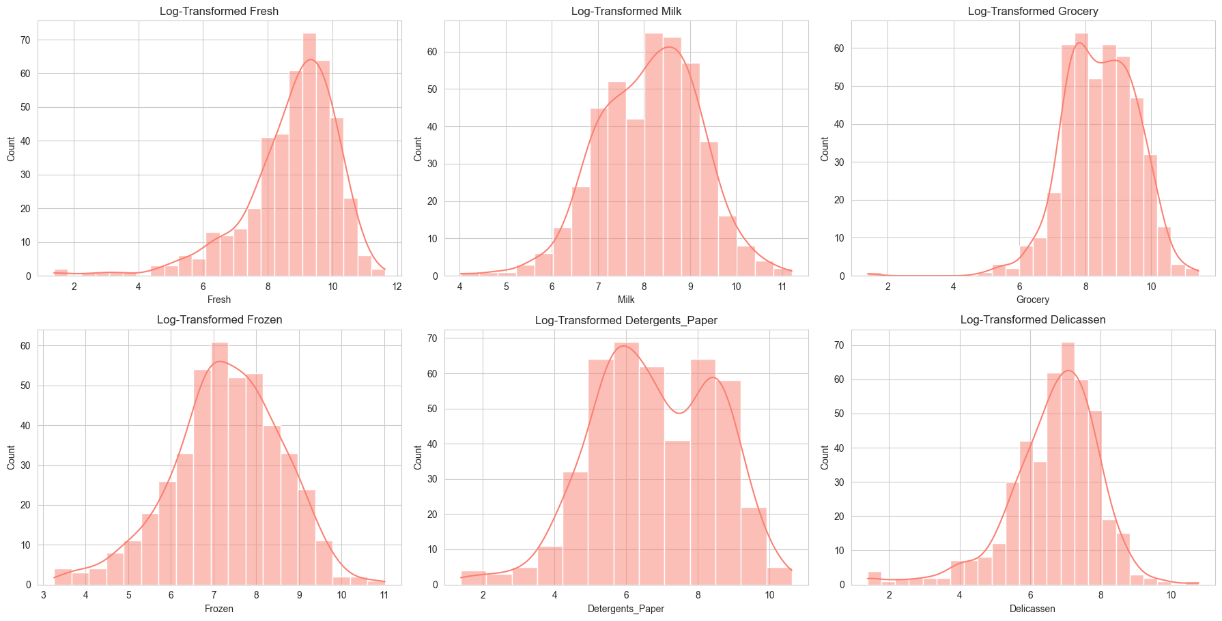
Log transformation after

Slide 5
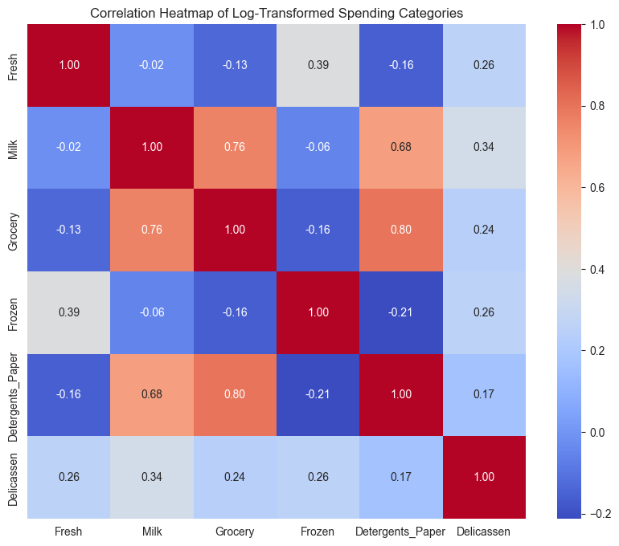
Correlation heatmap (what customers buy)

Slide 6
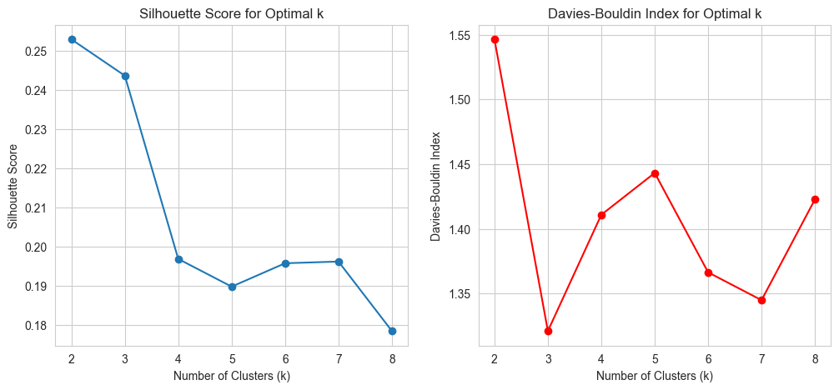
Silhouette Score and Davies-Bouldin Index plots.

Slide 7
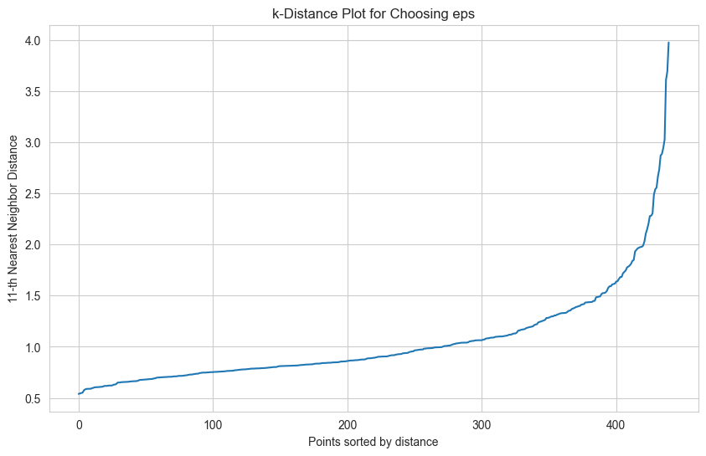
k-Distance Plot.

Slide 8
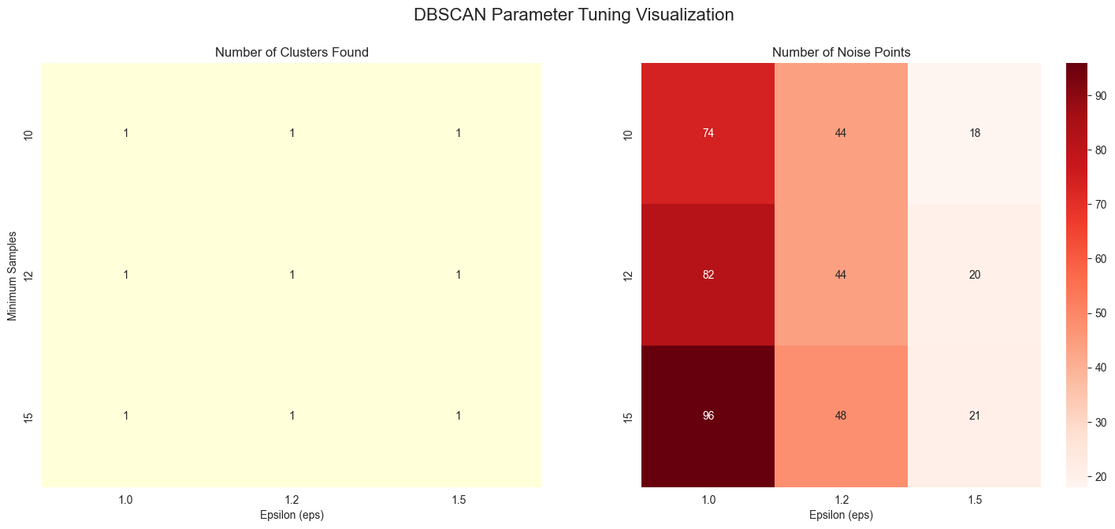
DBSCAN Parameter Results

Slide 9
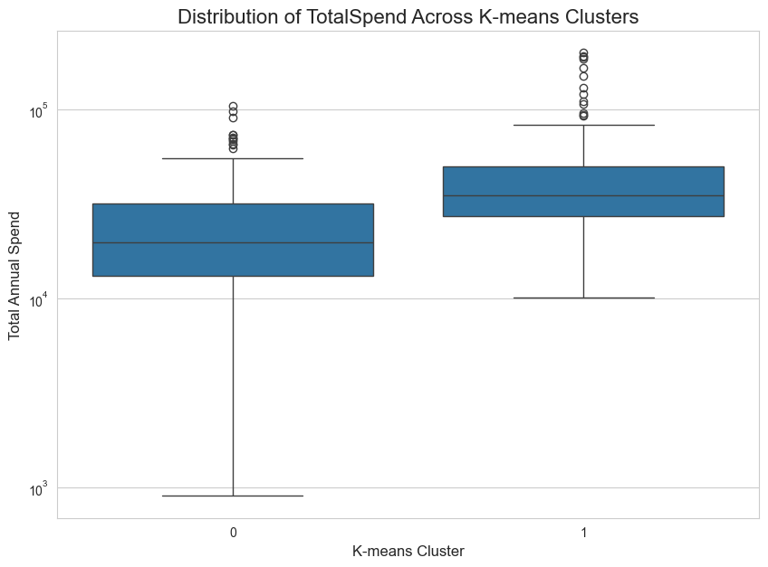
Boxplot of TotalSpend across K-means clusters.

Slide 10
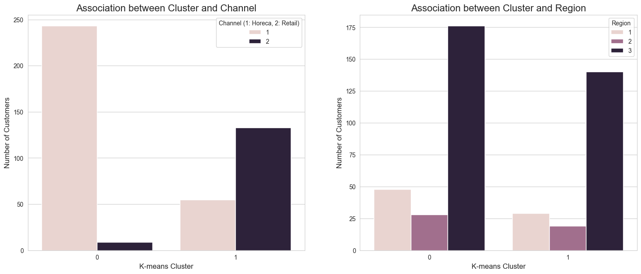
Count plots for association between cluster and channel / region

Slide 11
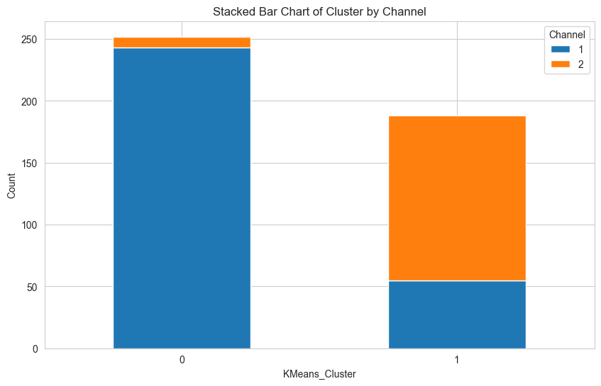
Continuation

Slide 12
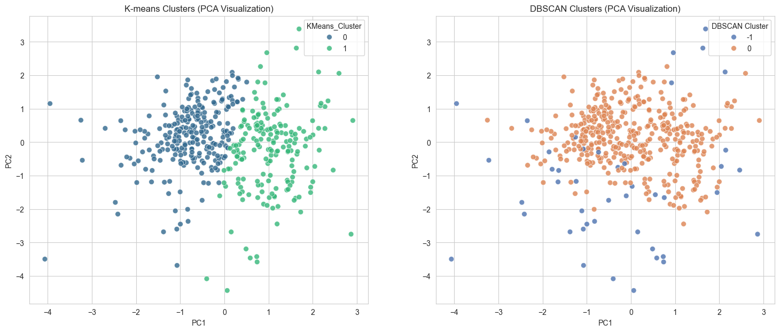
2D PCA Scatter Plots for K-Means and DBSCAN.

